Slide 1
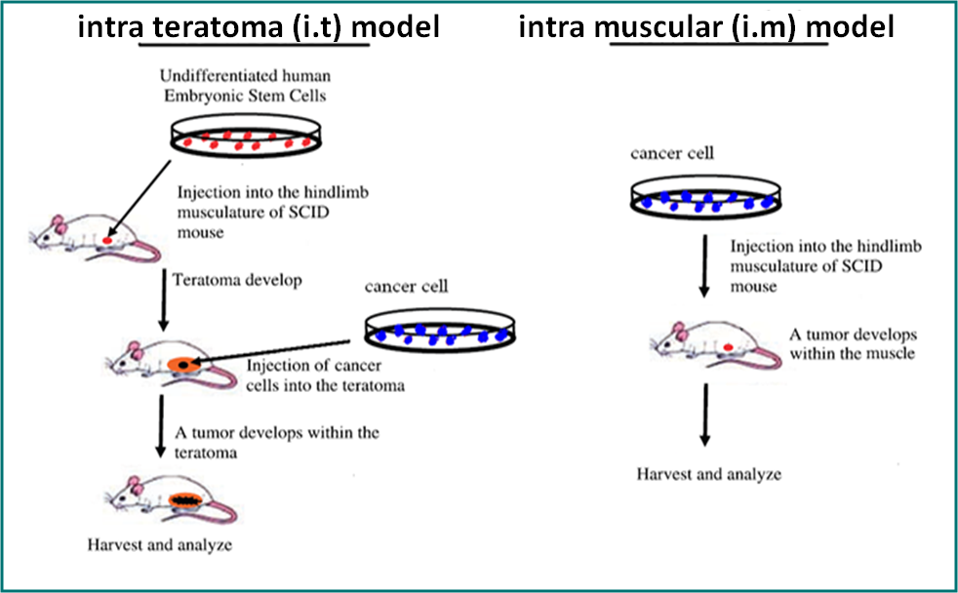
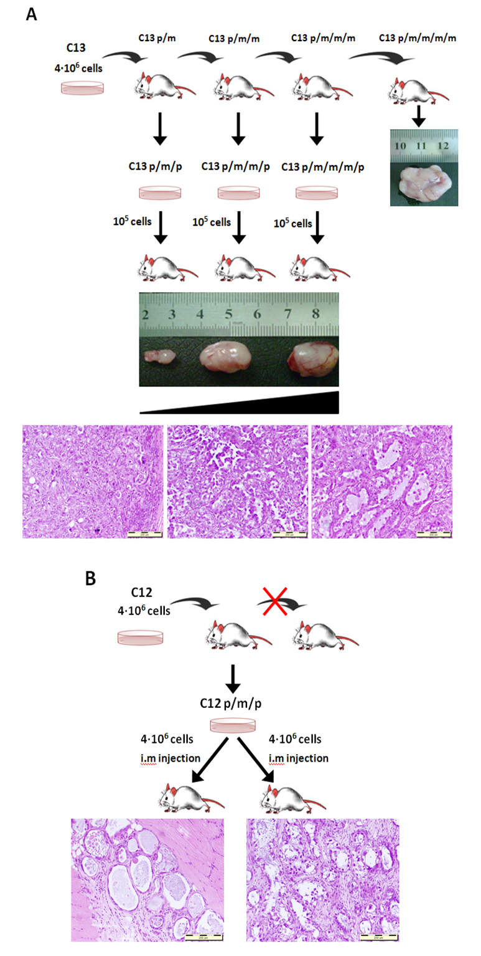
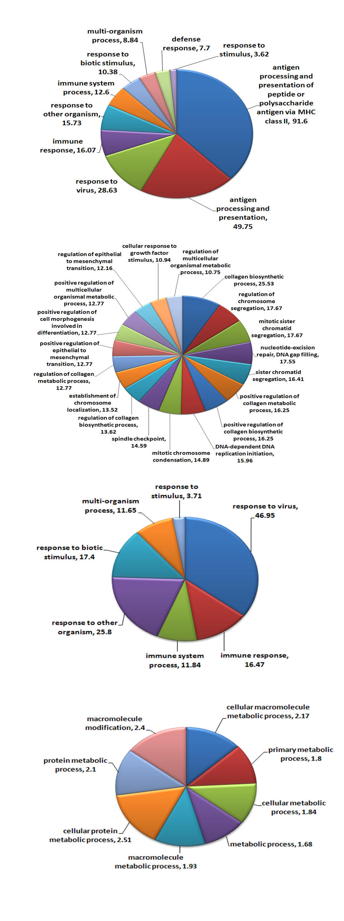
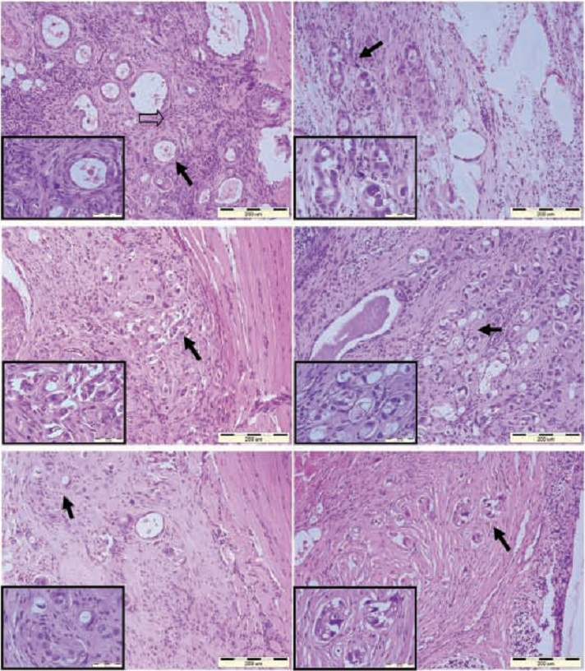
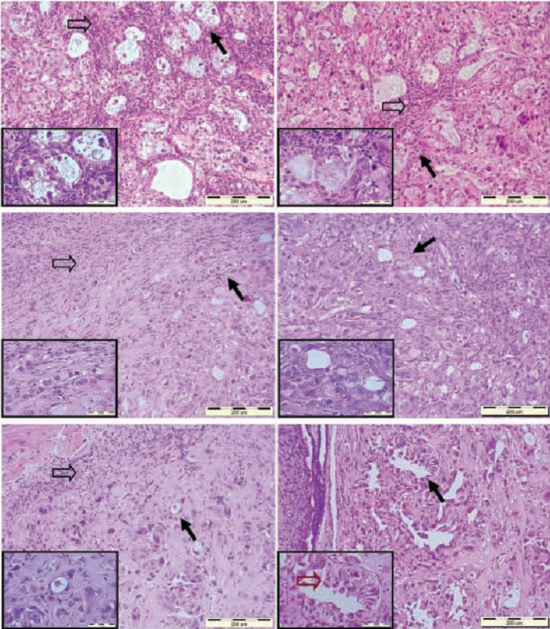
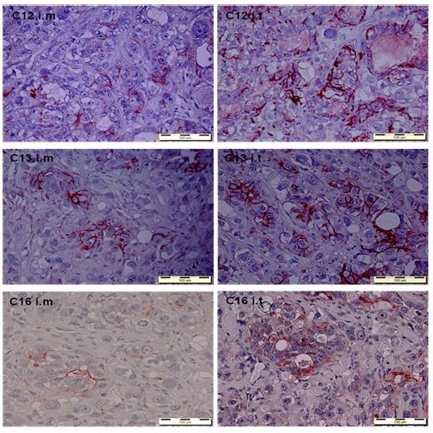
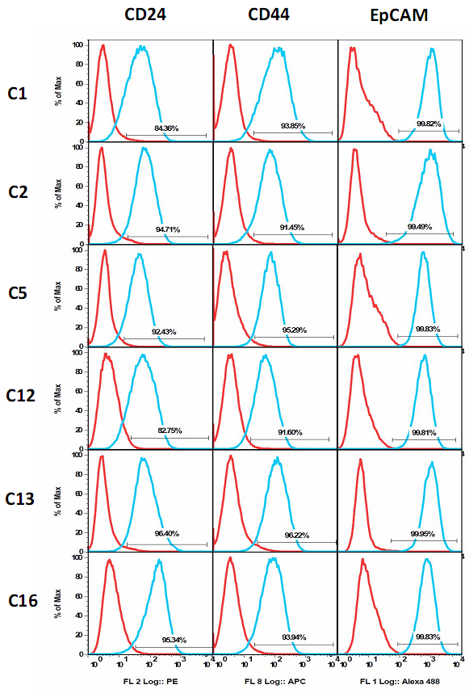
Microenvironment-dependent intratumoral heterogeneity in the self-renewal and tumorigenic differentiation of ovarian cancer
Abelson Sagi , Shamai Yeela , Berger Liron , Reiter Irena, Shouval Roni , Skorecki Karl and Tzukerman Maty.
Molecular Medicine Laboratory, The Ruth and Bruce Rappaport Faculty of Medicine, Technion-Israel Institute of Technology, Haifa, Israel.
Abstract
Introduction: Solid tumor complexity emanates from the requirement of a supportive microenvironment that provides a compatible network of interactions between the heterogeneous cancer cells and various tumor supporting cells. We have established and validated a tumor microenvironment model based on the potential of human embryonic stem cells (hESC) to generate in vivo teratomas, comprised of a wide variety of differentiated tissues and structures, for studying human tumorigenesis. We have extended this approach to examine the attributes of such a cellular microenvironment in supporting the growth of human cancer cells freshly harvested from malignant ovarian ascites and to determine whether there are differences among subsets of ascites derived cancer cells in terms of tumorigenic capacity, self renewal and tumorigenic differentiation capacities, in the conventional murine xenograft model and in the hESC- derived microenvironment. Material and Methods: Human cancer cells were harvested from malignant ovarian ascites fluid collected from a 64-year-old patient diagnosed with stage IV clear cell carcinoma of the ovary. Separation processes enabled the identification and characterization of six different cancer cell subpopulations (CCSPs). Results: Only four of the six CCSPs developed into tumors in a conventional xenograft model; all six of the CCSPs robustly generated tumors in the hESC-derived cellular microenvironment, demonstrating niche dependent tumorigenic capacity. Detailed analyses indicate that the CCSPs are six different 'cancer stem cell' (CSC) populations that exhibit the capacity for both self-renewal and tumorigenic differentiation in a niche-dependent manner, and are characterized by the expression of specific markers for CSC. Remarkably – in the embryonic stem cell based model – these ovarian cancer cell subpopulations from a single patient – recapitulated the broad repertoire of properties that can be seen in tumors observed across the entire spectrum of many different patients. Despite the diverse histological phenotypes and niche preferences, genomic analyses demonstrated a monoclonal tumor origin for the different subpopulations. Moreover, the hESC-based model, exposed subpopulations of ovarian CSC – which are believed to serve as relevant targets for a sustained response with anti-cancer therapy. Accordingly we have performed gene expression analyses using laser micro-dissected tissues from tumors generated in both in vivo models to examine the attributes of the hESC-based model in supporting the capacity of distinct CCSPs to generate tumors and the maintenance of CSC properties such as self-renewal and tumorigenic differentiation. Conclusions: We suggest that the hESC-based model provides an integrated platform to critically scrutinize the ‘cancer stem cell’ paradigm and to develop and test multimodal anti-cancer therapies.
Results
5. In vivo self-renewal capacity of CCSP C13 and C12
6. Gene expression profile analysis
1. In vivo experimental models for Tumorigenesis
According to the Cancer Stem Cell model, the CSC are characterized by two important capacities: 1) the capacity for self-renewal and, 2) the capacity for tumorigenic differentiation. To asses the different CCSPs capacity to self-renew in vivo we performed serial transplantation analysis.
RNA samples extracted from laser micro-dissected tissues were used for whole genome microarray analyses. Statistically significant GSEA (Gene Set Enrichment Analysis) gene sets were subjected to Leading Edge analysis and the resulting gene lists were grouped according to ontological terms of biological processes category. This analysis demonstrates the hESC-derived microenvironment is a better supporting model for studying ovarian clear cell cancer . As opposed to the conventional murine model, the hESC-based model demonstrates a greater complexity of cancer cell-microenvironment interaction. These results demonstrate that the murine microenvironment is incapable to discriminate between different cancer cell populations of a single tumor and therefore excessively simplify tumor progression events.
Figure 3. (A) CCSP C13 was able to perpetuate into a secondary recipient mouse forming a tumor with a similar morphological appearance. C13 derived tumors generated in late recipient mice, demonstrate the
full spectrum of histological appearance of ovarian clear cell carcinoma observed in the patient original tumor. (B) CCSP C12 failed to generate a palpable tumor when transplanted into a secondary recipient mouse following i.m injection but did generate robust tumor when injected i.t.
C12 i.m
2. Niche-dependent tumorigenic capacity
Certain CCSPs that did not develop into tumors in a conventional murine xenograft model did generate tumors in the hESC-based cellular microenvironment, indicating variable niche dependent tumorigenic capacity for the different CCSPs. The hESC-based model provides an improved niche for supporting growth of certain tumor cell subpopulations.
C12 i.t
Table 1. Tumorigenic capacities of the six CCSPs isolated from the bulk malignant ovarian ascites in the hESC-based microenvironment and in the direct tumor xenograft model.
3. Heterogeneous tumor histological phenotype for the different CCSPs
i.m
i.t
i.m injection
i.t injection
C1
Figure 1. In vivo phenotypic appearance of the different CCSPs.
Paraffin sections stained with H&E of tumors generated following i.m or i.t injections. Higher power magnification of the areas indicated by the filled arrows in each tumor is shown in the small inset. Open arrows indicate fibroblast-like cells lining the spaces between the glandular structures in tumors generated by CCSP C1 and C12 and fibroblast-like cells lining the i.m tumors generated by CCSP C13 and C16. The brown open arrow in the small inset of i.t tumor generated by CCSP C16 points at highly differentiated hobnail-shaped cells. Bars, 200 µm (large tumor picture) and 50 µm (small inset).
C2
6. Niche-dependent support of CD44+ expressing cells
C13 i.m
C5
Immunohistochemistry analysis of tumors generated i.m and i.t exhibit niche-depended CD44 expression pattern. In the murine tissue, CSC properties of the CCSPs i.e. CD44 expression and self-renewal are maintained only in a minority of the cells (left panel). We observed clusters of large CD44 expressing cells with large nuclei and a low cytoplasm/nucleus ratio surrounded by cells which are negatively stained for CD44, have higher cytoplasm/nucleus ratio and appear as clear cells that might represent differentiating derivatives of the CD44+ CSC. On the other hand, in the hESC-based niche, the microenvironment maintains CSC self-renewal and CD44 expression as opposed to differentiation. Both the number of stained clusters and the intensity of the staining were higher than in tumors generated i.m (right panel).
C12
C13
C13 i.t
C16
4. ‘Cancer stem cell‘ associated markers
Figure 2. Characterization of the CCSPs surface phenotype. Flow cytometry analysis of the six CCSPs using PE conjugated anti-CD24, APC conjugated anti-CD44 and alexa488 conjugated anti-EpCAM antibodies was preformed. Red color histograms represent negative controls, green color histograms represent the positive staining of the six CCSPs. This analysis determined a surface phenotype of CD44+/ CD24+/ EpCAM+ for all the six CCSPs.
Figure 5. Pie chart diagram representation of enriched gene ontology terms and their matching enrichment score
Conclusions:
a) The six different CCSPs are heterogeneous ovarian cancer cell subpopulations originating from a single tumor. These findings indicate the urgent need for developing multimodal anti-cancer therapeutic strategies aimed for ultimate eradication of all cancer cells that comprise the tumor mass.
b) The hESC-derived model demonstrates complex and supportive tumor-microenvironment interactions that promote growth of certain CCSPs that fail to develop into tumors in the conventional mouse xenograft model. Therefore, these CCSPs might not be accessible to anti-cancer therapy tested in currently used murine xenograft models.
*High ALDH1 activity levels were observed for each CCSP (data not shown).
Figure 4. CD44 expression in CCSPs derived tumors. Paraffin sections of C12, C13 and C16 derived tumors were subjected to immunohistochemistry staining with anti-CD44 antibody. Arrows represent clusters of CD44+ cells. Bars: 100µm.
c) The gene expression profiles, obtained from the two distinct CCSPs (Figure 5), reveal that in contrast to the hESC-derived microenvironment, the murine microenvironment fails to discriminate between different subpopulations of a single tumor. The enriched groups of genes in the i.m model are involved in processes related to immune response as expected from an interaction between human cancer cells with the heterologous external environment.

